Slide 1
PUBLIC TRANSPORTATION EFFICIENCY ANALYSIS

Slide 2
Introduction
The operational performance analysis of firms has witnessed a revolution since the late 1970s [1]. Naturally, it has led to comparisons between firms and the public sector, paving the way for benchmarking analysis.
This concept first appeared in 1989 [2], popularized by Xerox.
economic theory of optimizing behavior as deviations from best practices, and enables the proposition of feasible corrective goals [3].

Slide 3
Smart bus transportation for tracking system:
Design a wireless sensor network that automatically identified and provided accurate information about travel routes and the movement of public transport buses in real-time, contributing to the time management of public Transport users in their activities.
The current public transportation system must improve the quality of its services so that they can go hand in hand with technological advancements.

Slide 4
Advanced technology's of this analysis
5G, the Internet of Things (IoT), 5G cellular devices and edge computing
The IoT is one of the most compelling new technologies for the transport industry.
7 technologies that will help public transportation to adapt
Mobility as a service (Maas)
Artificial intelligence
Tackling data's silos with clouds
Internet of things (Iot)
Real time decision making
Better means of communication
Digital twins and simulation

Slide 5
7 Technologies
7 technologies that will help public transportation to adapt
Mobility as a service (Maas)
Artificial intelligence (AI)
Tackling data's silos with clouds
Internet of things (Iot)
Real time decision making
Better means of communication
Digital twins and simulation

Slide 6
smart technology transportation :
Smart transportation refers to the integrated application of modern technologies such as cloud computing, wireless communication, location-based services, and computer vision into the transportation system
How has technology improved travel?
When it comes to booking or changing reservations, mobile apps and sites have completely transformed the modern traveler's experience. Customers now have control of their reservation in the palm of their hand and can make updates quickly without interacting with a customer service agent.

Slide 7
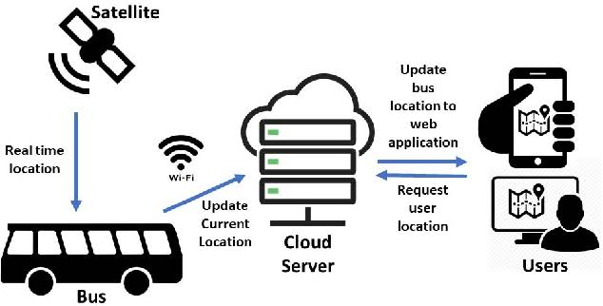
Diagram for advanced transportation system

Slide 8
Thank you.

